Slide 1
Software Engineering
CS20006
Lecture 6
Unified Modeling Language

Slide 2
Lecture #07
Unified Modeling Language
Introduction to UML
Applications of UML
UML Definition
Learning UML
Things in UML
Structural Things
Behavioral Things
Grouping Things
Annotational Things
Relationships in UML
Diagrams in UML

Slide 3
Introduction to UML

Slide 4
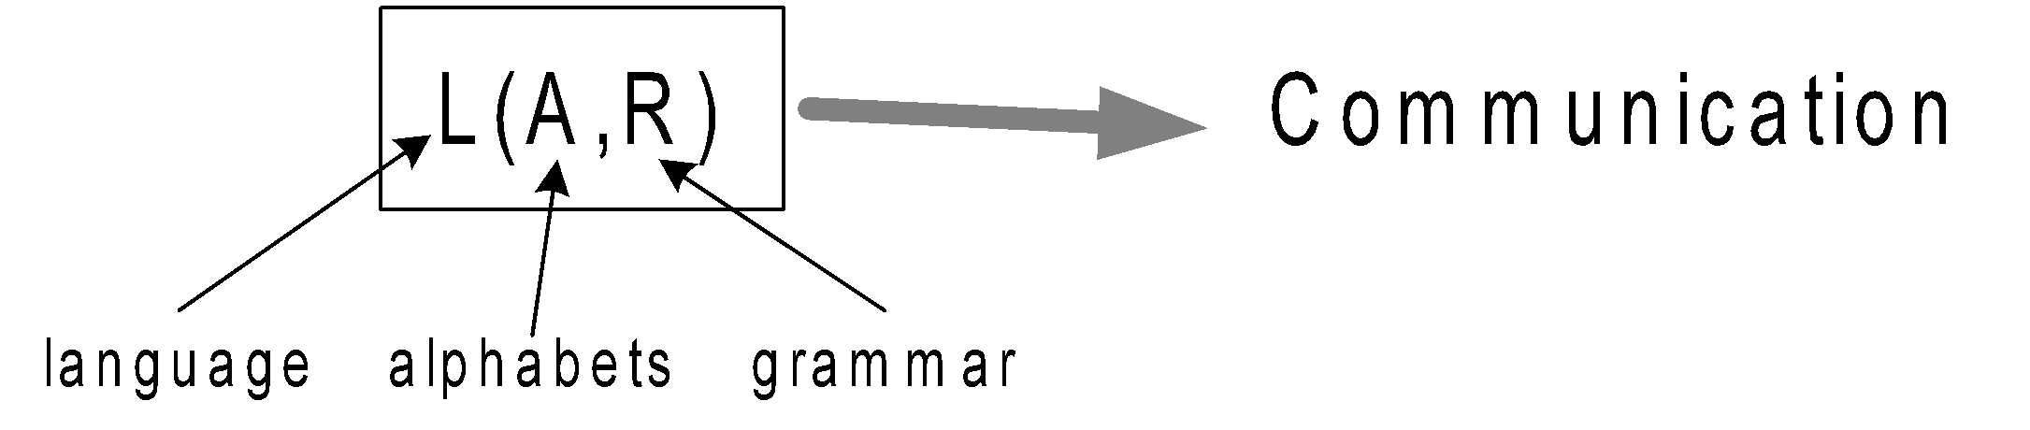
Introduction to UML
UML is an abbreviation of Unified Modelling Language
UML is a language
It has a set of vocabulary (like rectangles, lines, ellipses etc.) and the rules for combining words in that vocabulary for the purpose of communication
UML is a graphical language

Slide 5
Introduction to UML
UML is a modeling language
UML is a language to create models (software blue prints) of software intensive systems
UML focuses on conceptual and physical representation of a system

Slide 6
Introduction to UML
UML is a unified modelling language
It provides a standard for modeling a system, the standard was derived from previously exercised methodologies such as
Booch’s Methodology
by Grady Booch (1991)
Object Modeling Technique (OMT)
by James Rumbaugh (1991)
Object Oriented Software Engineering (OOSE)
by Ivar Jacobson (1992)

Slide 7
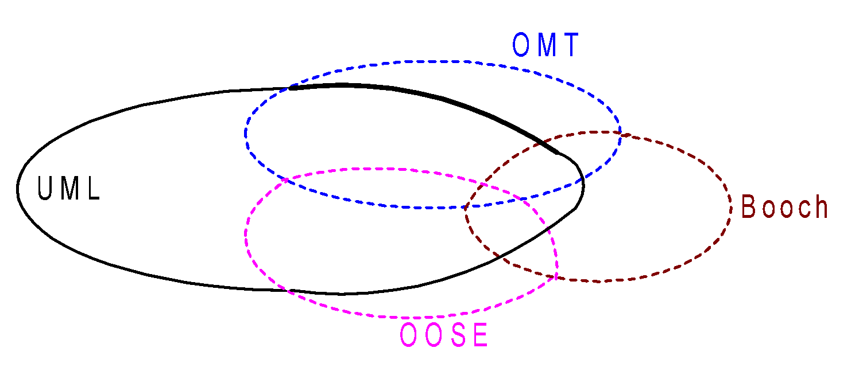
Introduction to UML
UML is a unified modelling language
UML is developed by Grady Booch, James Rumbaugh and Ivar Jacobson towards the direction of an unification effort
UML was adopted by Object Management Group (OMG) and became a de facto standard in 1997
Details on UML and its evolution can be seen in www.omg.org

Slide 8
Applications of UML

Slide 9
Applications of UML
The UML is appropriate for modeling systems ranging from enterprise systems to distributed web based applications and even to hardcore real time embedded systems
UML follows object oriented approach and hence the best deals with object oriented analysis and design (OOA&D) of systems

Slide 10
Definition of UML

Slide 11
Definition of UML
The UML is a language for
Visualizing
Specifying
Constructing
Documenting
the artifacts of a software-intensive system

Slide 12
Definition of UML : Visualizing
Visualizing
UML models a system to facilitate communication for all range of people

Slide 13
Definition of UML : Specifying
Specifying
UML builds models that are precise, unambiguous and complete.
In particular, UML addresses the specification of all the important analysis, design and implementation decision that must be made in developing and deploying a software system

Slide 14
Definition of UML : Constructing
Constructing
UML models can be directly mapped to
An object oriented programming language such as C++, Java or Visual Basic
Tables in relational database
Persistent store of an object-oriented database
This permits forward engineering: the generation of a code from a UML model into a programming language

Slide 15
Definition of UML : Constructing
It also permits reverse engineering: One can reconstruct a model from an implementation back into the UML
Reverse engineering requires tools support with human intervention
Roundtrip engineering: combining the two paths of forward code generation and reverse engineering
Meaning the ability to work in either a graphical or technical view
UML keeps two views consistent

Slide 16
Definition of UML : Documenting
Documenting
UML facilitates all sorts of system artifacts like requirements, design, project planning, coding, testing, prototyping, maintenance, release, etc.
These artifacts not only the deliverables of a project, they also in controlling, measuring and communicating about a system during its development and after its deployment

Slide 17
Learning UML

Slide 18
Learning UML
There are three major elements in UML
Basic building blocks (vocabulary of the language)
The rules how these building blocks can be put together
Some common mechanism that can be applied throughout the UML

Slide 19
Basic Building Blocks in UML
Vocabulary of the UML encompasses three kinds of building blocks
Things
Things are abstractions in a model
Relationships
Relationships tie the things together
Diagrams
Diagrams group relevant collection of things

Slide 20
Basic Building Blocks: Things
There are four kinds of things in the UML
Structural things
Behavioral things
Grouping things
Annotational things

Slide 21
Structural Things in UML

Slide 22
Structural Things in UML
Relevant things that are either conceptual or physical
Examples: class, object, etc.
Structural things are nouns in the UML model
There are seven structural things in UML
Class
Active class
Component
Interface
Use case
Collaboration
Node

Slide 23
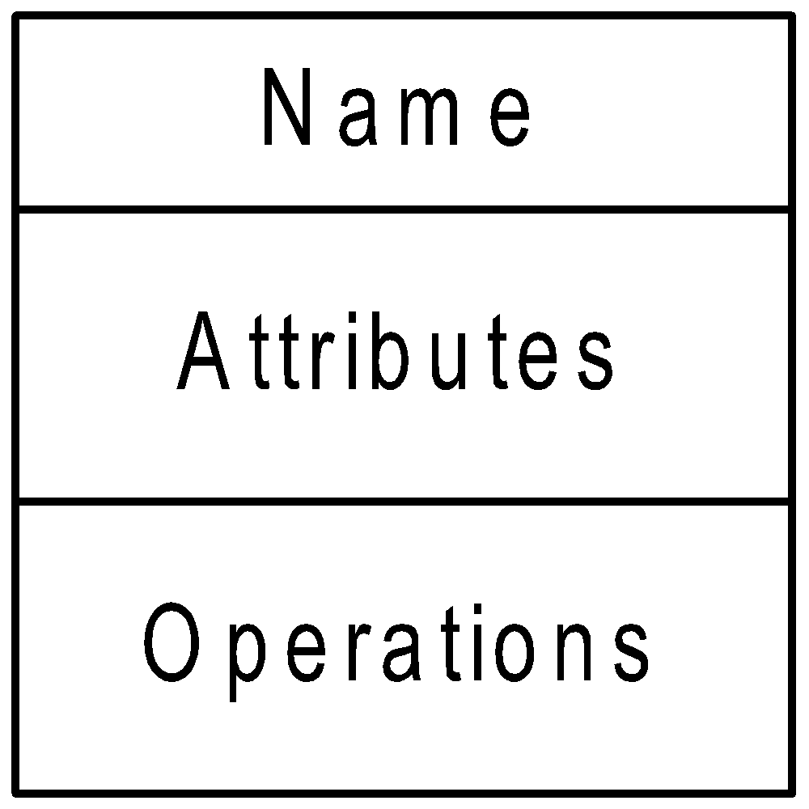
Structural Things: Class
Class
A class is a description of a set of objects ( or an abstraction of object)
Graphically a class is represented as a rectangle, including its name, attributes, and operations

Slide 24
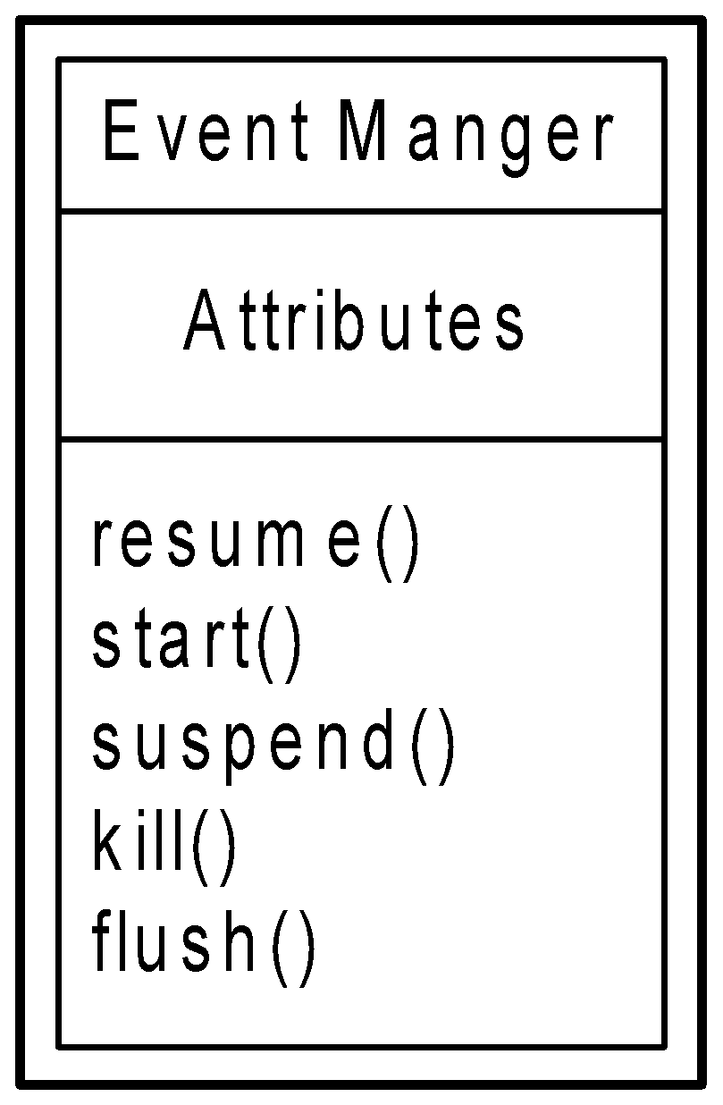
Structural Things: Active Class
Active Class
An active class is just like a class expect that its object represent element whose behavior is concurrent with other elements
An object of an active class owns one or more processes or threads and therefore initiate control activity
Graphically, an active class is denoted just like a class, but with a heavy line, usually including its name, attributes, and operations

Slide 25
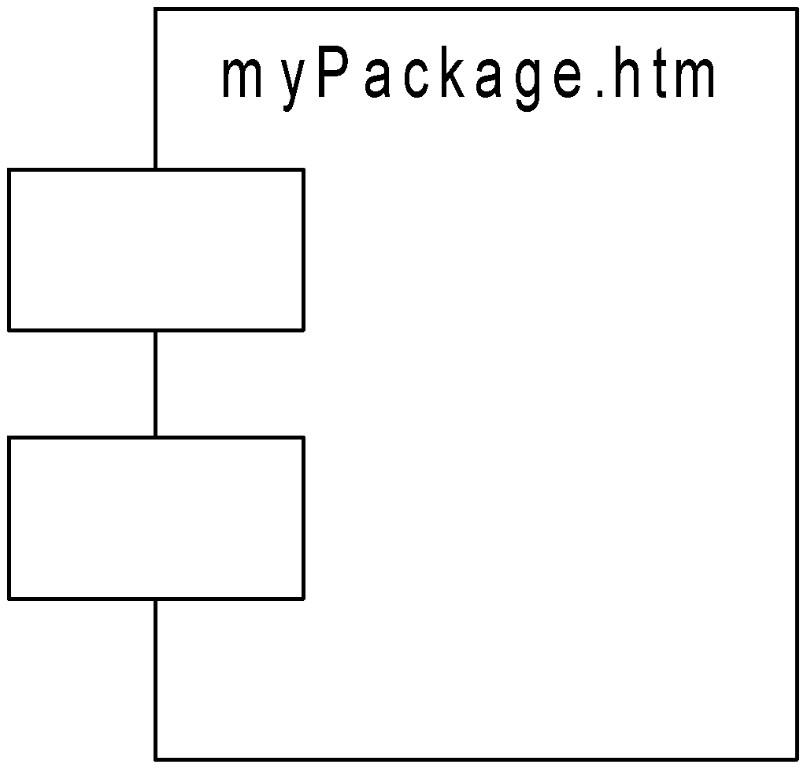
Structural Things: Component
Component
Component of a system is to conform with the realization of a set of interfaces
Example: An applet, component, Java bean or ASP file. In fact, a component is typically represents a physical package of otherwise logical elements such as classes, interfaces and collaborations
Graphically a component denoted as a rectangle with tabs, usually including only its name

Slide 26
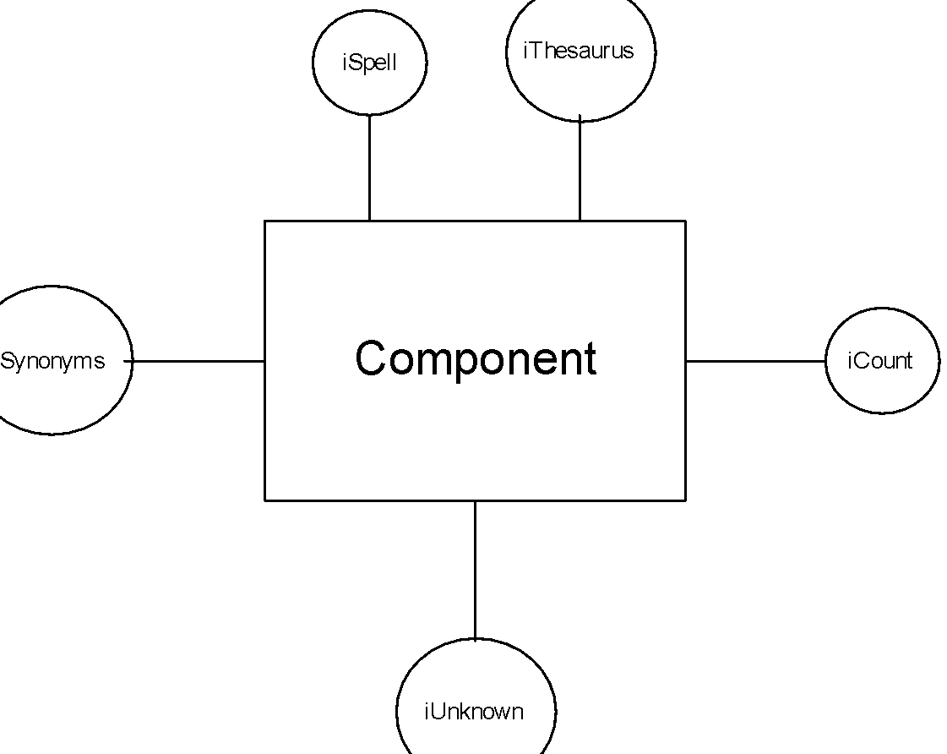
Structural Things: Interface
Interface
An interface is a collection of operators that specify a service of a class or a component
In UML, Interfaces are used to model the seams (layers) in a system
Graphically, an interface rendered as a circle together with its name
Note: An interface rarely stands alone, rather it is attached to a class or component

Slide 27
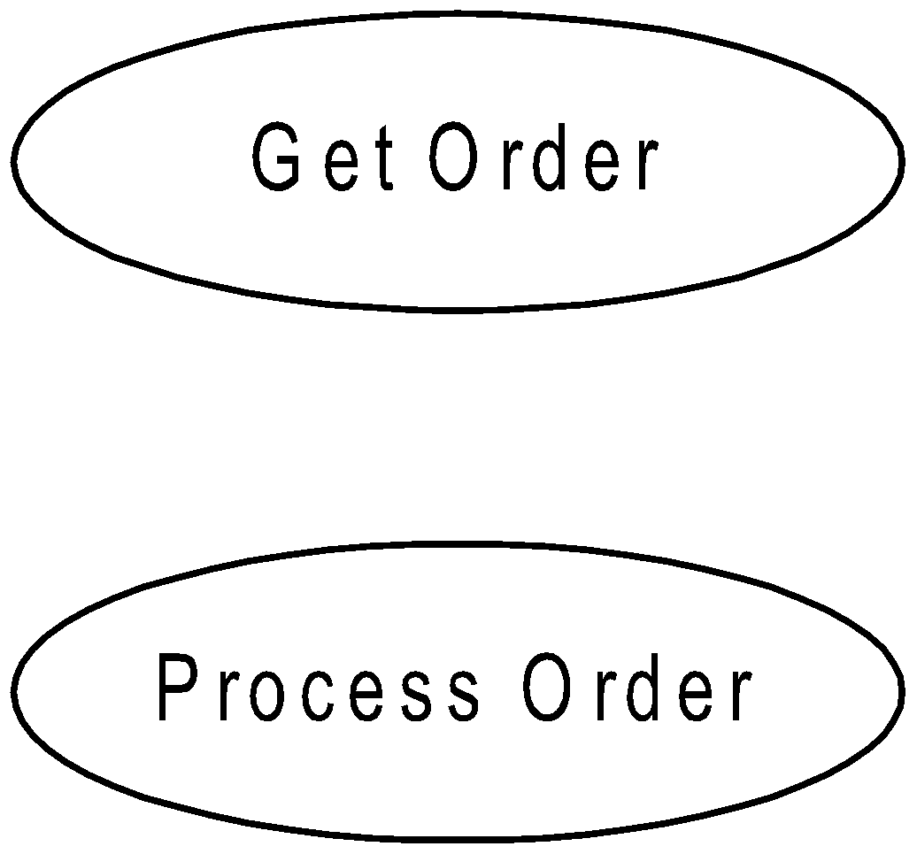
Structural Things: Use case
Use case
Use case represents a functional component in a model
Graphically, a use case is represented by an ellipse including only its name

Slide 28
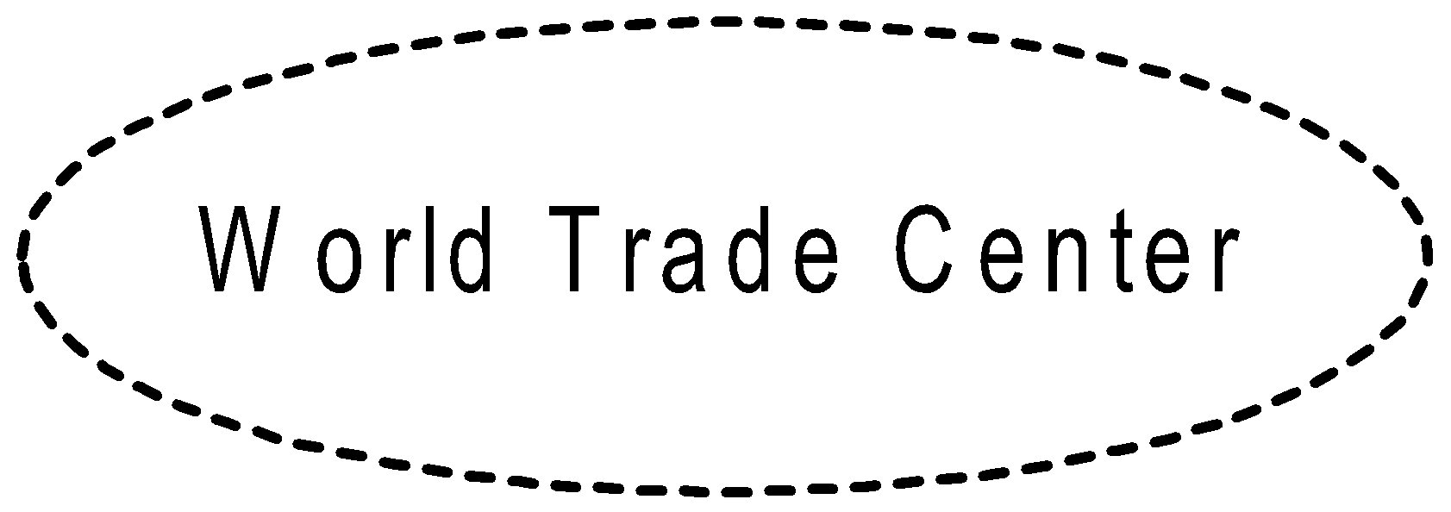
Structural Things: Collaboration
Collaboration
A collaboration names a society of classes, interfaces, and other components that work together to provide cooperative behavior that is bigger than the sum of its individual parts
Example:
A big building (world trade center) is a collaboration of some structural construction, electrical wiring system, telephone connectivity, internet connectivity, water supply system, etc.
Graphically, a collaboration is rendered as an ellipse with dashed line

Slide 29
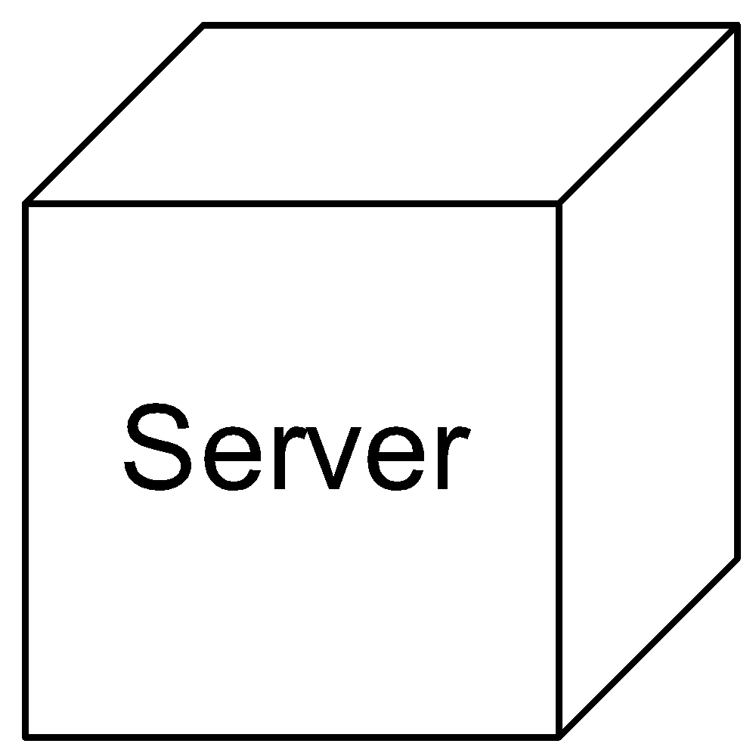
Structural Things: Node
Node
Node is a physical element and represent a computational resource, generally having same memory and processing compatibility
Graphically, a node is denoted by a cube, usually includes its name

Slide 30
Behavioral Things in UML

Slide 31
Behavioral Things in UML
Unlike structural things, behavioral things are to represent dynamic parts of UML models. Structural things are the mostly static parts of the model and are the nouns of the UML model
In the contrary, behavioral things are the verbs of UML models
There are two primary kind of behavioral things in the UML
Interaction
State machine

Slide 32
Behavioral Things: Interaction
Interaction
An interaction is a behavior that comprises a set of messages exchanged among a set of objects within a context to accomplish a purpose
Basically, interaction used to link two instances of classes (objects), and through which one object can send a message to the other object

Slide 33
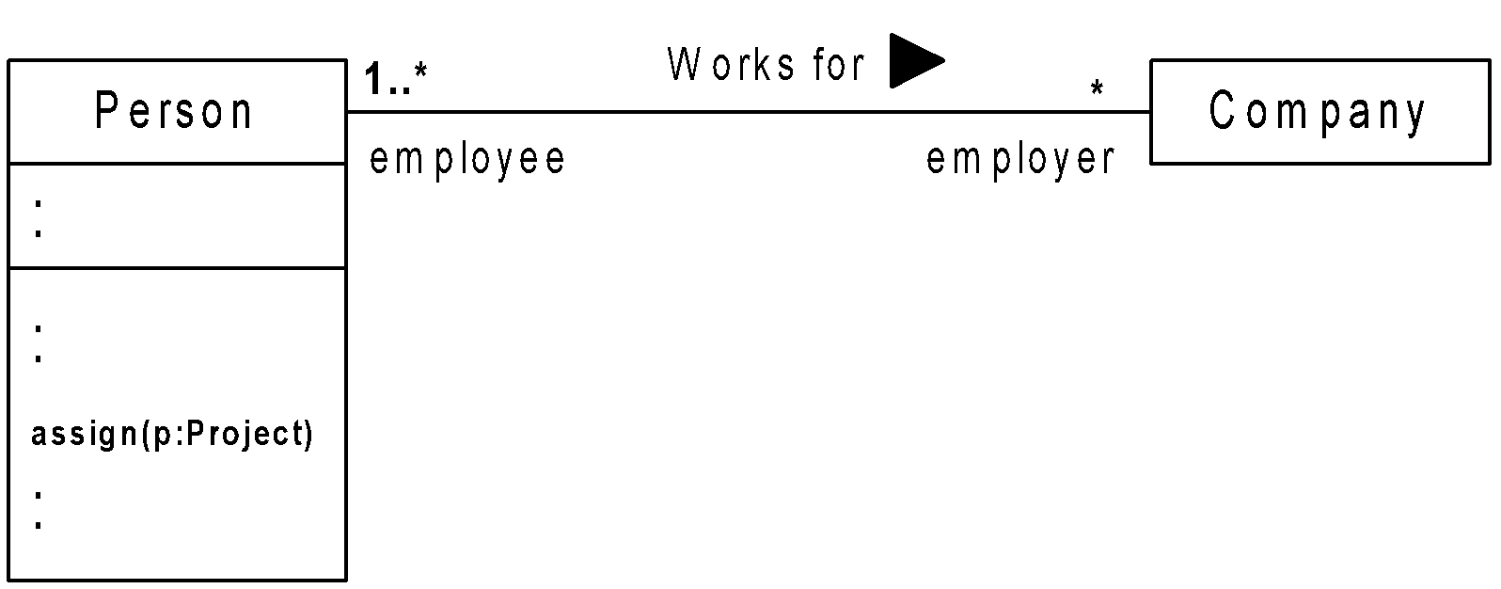
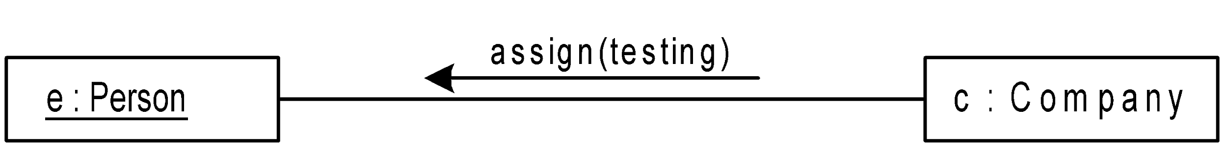
Behavioral Things: Interaction
Graphically, an interaction is represented as a directed line, usually including the name of its operation

Slide 34
Behavioral Things: State Machine
State machine
Using an interaction one can model the behavior of a society of objects that work together
On the other hand, using a state machine one can model the behavior of an individual object
A state machine is a behavior that specifies the sequence of states of an object goes through during its life time in response to a message

Slide 35
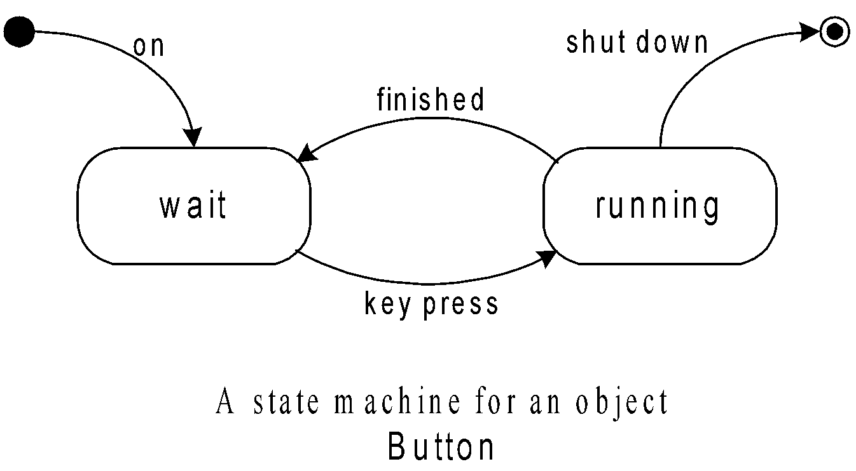
Behavioral Things: State Machine
Graphically, a state is denoted by a rounded rectangle, including its name and its states, if any
Note: These two behavioral things are usually connected though various structural elements like classes, collaborations, objects, etc.

Slide 36
Grouping Things in UML

Slide 37
Grouping Things in UML
Visualizing, specifying, constructing and documenting large systems involves manipulating potentially large members of classes, interfaces, components, nodes, diagrams, and other elements
It is therefore necessary to organize these things into larger chunks
In UML, grouping things have been planned for this purpose
In all, there is one primary kind of grouping things, namely, package

Slide 38
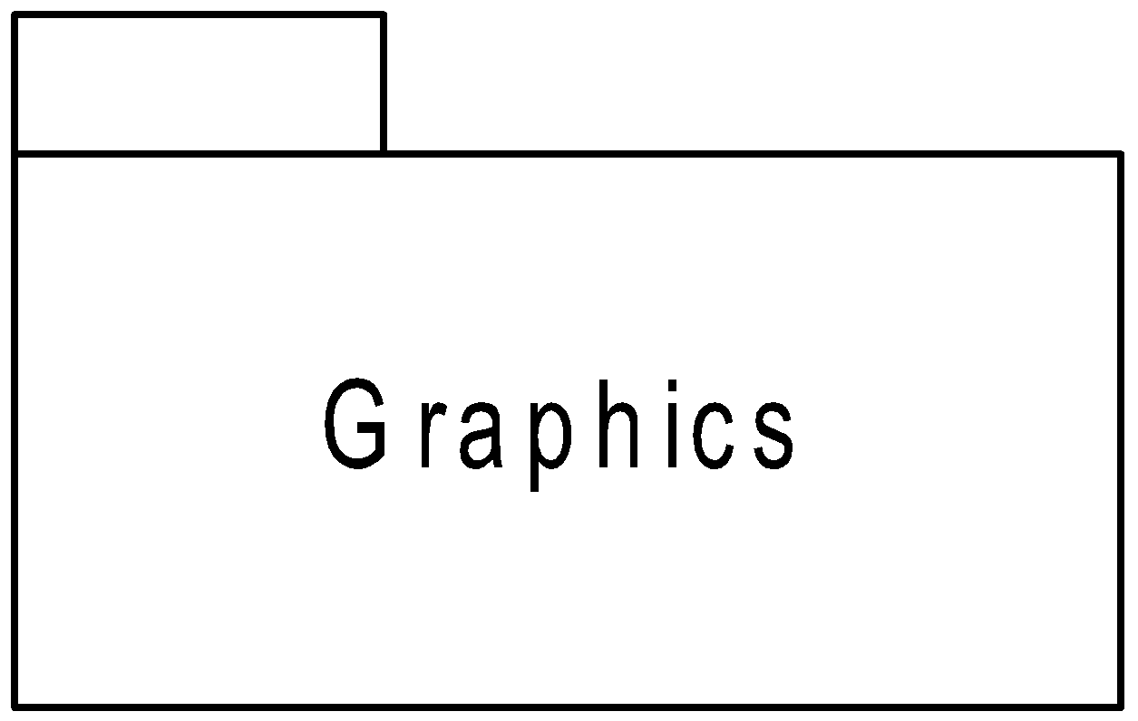
Grouping Things: Package
Package
A package is a general purpose mechanism for organizing elements into groups
Graphically, package is rendered as a tabbed folder, usually including only the name, sometimes references to its contents

Slide 39
Annotational Things in UML

Slide 40
Annotational Things in UML
Annotational things are the explanation parts of UML models
Designers follows these to describe, illuminate, and remark about any elements in a model
There is one primary kind of annotational things called note
A note is simply a symbol for renders a comment has no semantic impact, means, its contents has no effect on models

Slide 41
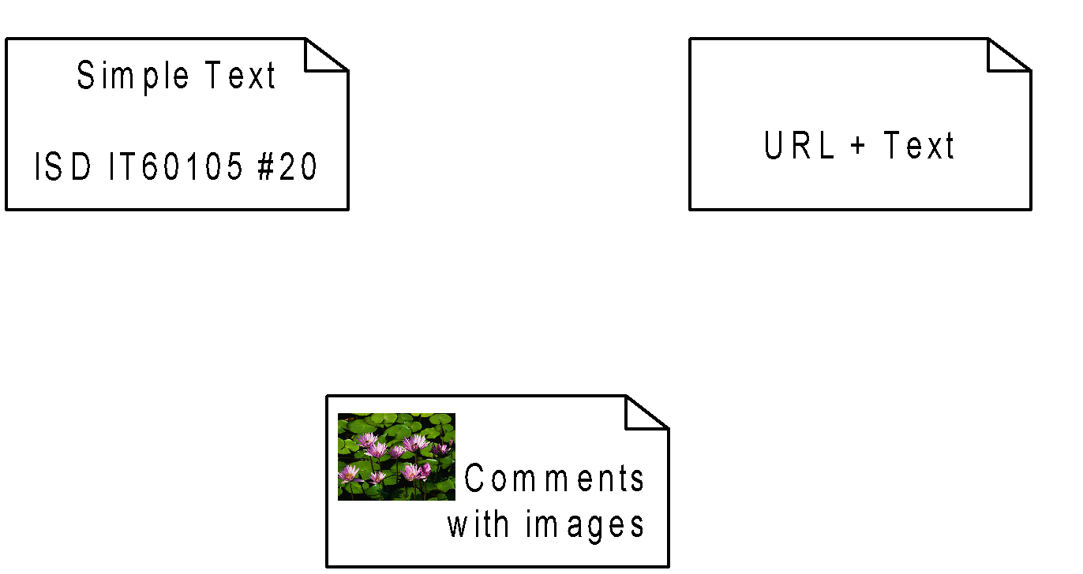
Annotational Things: Note
Graphically a note is rendered as a rectangle with a “dog earned” corner, together with a textual or graphical comment

Slide 42
Relationships in UML

Slide 43
Relationships in UML
A relationship is a concern among things
There are four relationships in the UML
Dependency
Association
Generalization
Realization

Slide 44
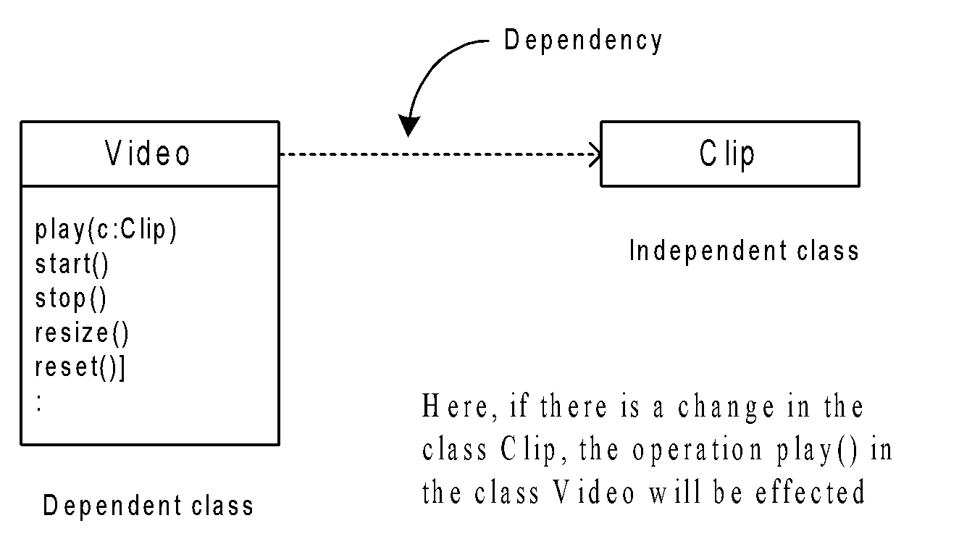
Relationships: Dependency
Dependency
A dependency is a semantic relation between two things in which a change to one thing (the independent thing) may affect another thing that use it, but not necessarily the reverse

Slide 45
Relationships: Association
Association
An association is a structural relationship that describe a set of links, a link being a connection among objects
Aggregation is a special kind of association, representing a structural relationship between a whole and its parts

Slide 46
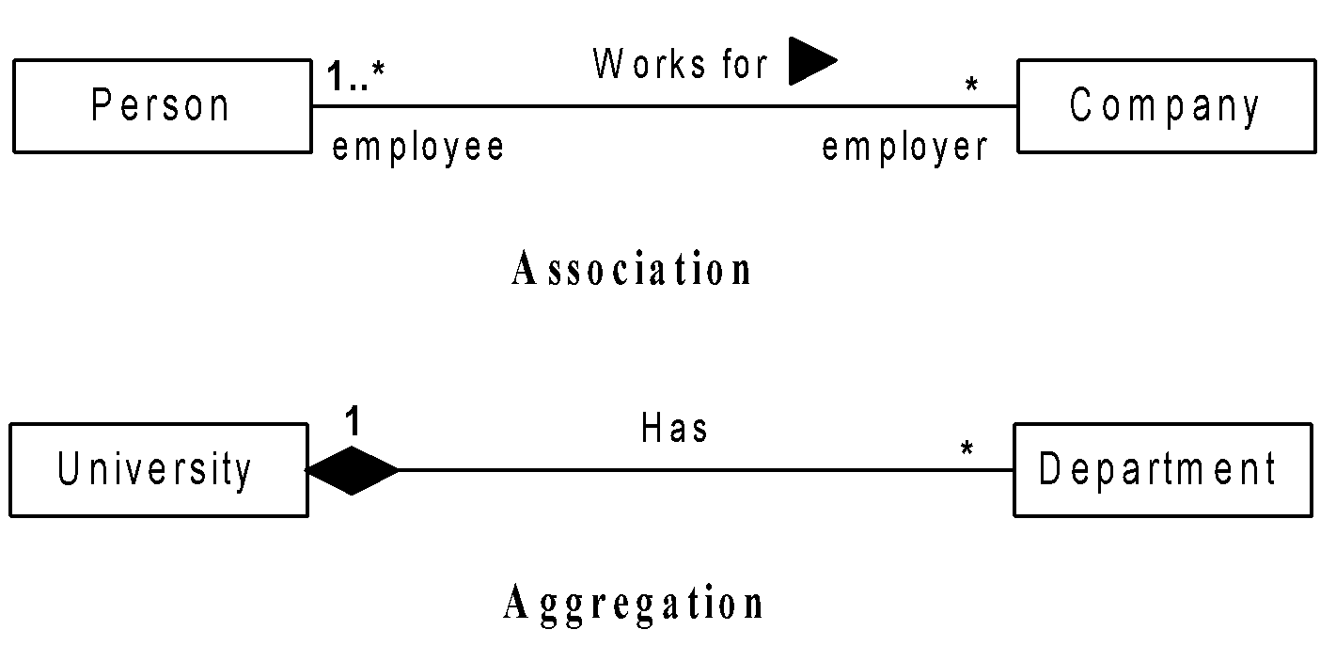
Relationships: Association
Graphically, association/aggregation is denoted with solid/diamond-edged line with label and multiplicities at both ends of line

Slide 47
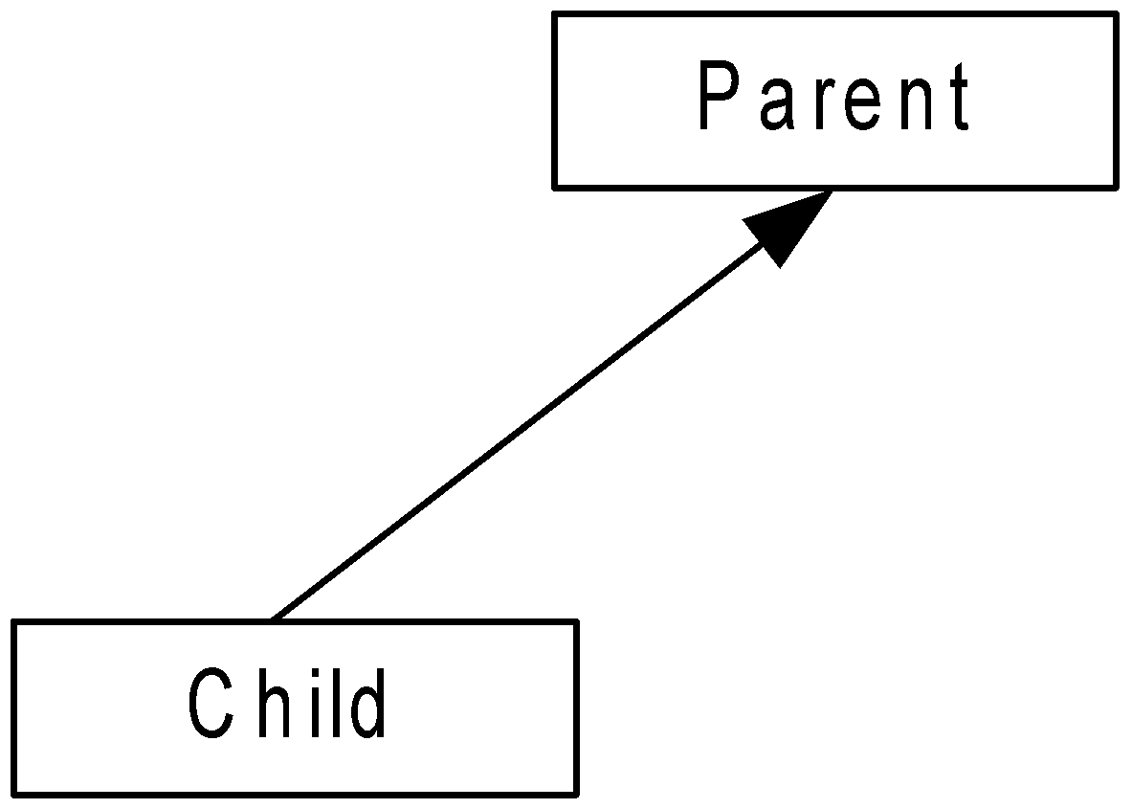
Relationships: Generalization
Generalization
A generalization is a generalized/specialized relationship in which objects of the specialized elements (the child), are suitable for objects of the generalized elements (the parent)

Slide 48
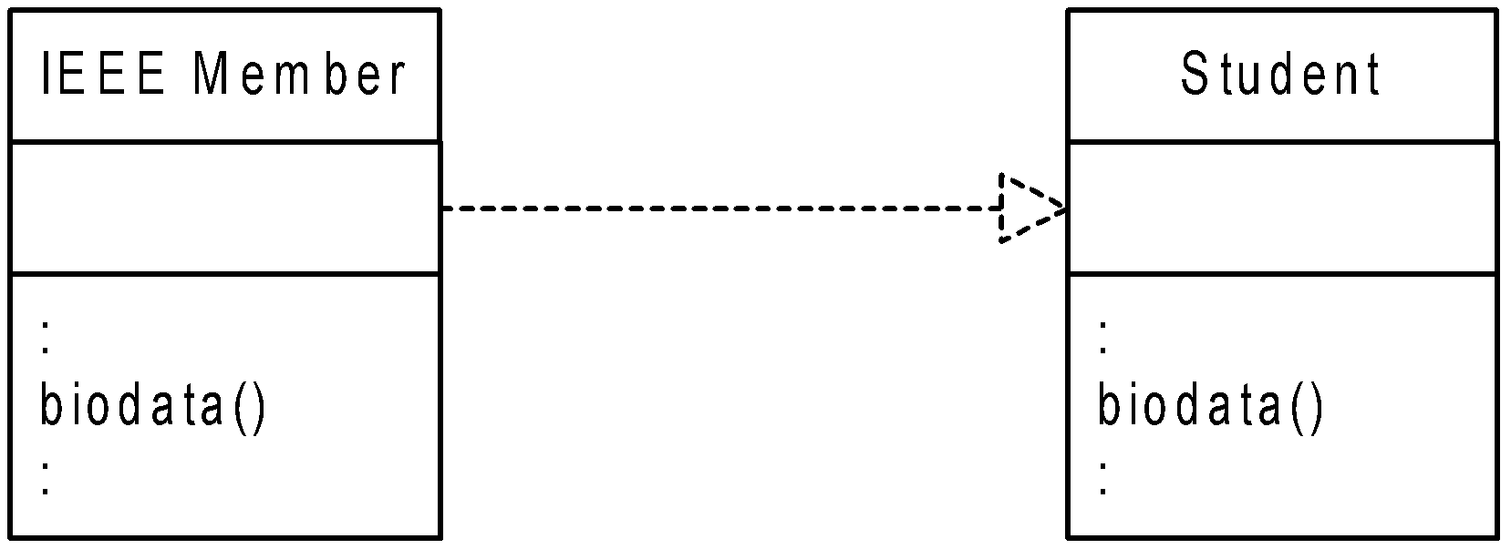
Relationships: Realization
Realization
A realization is a semantic connection
between two things: interface, class, component
between use-case and collaboration
etc.

Slide 49
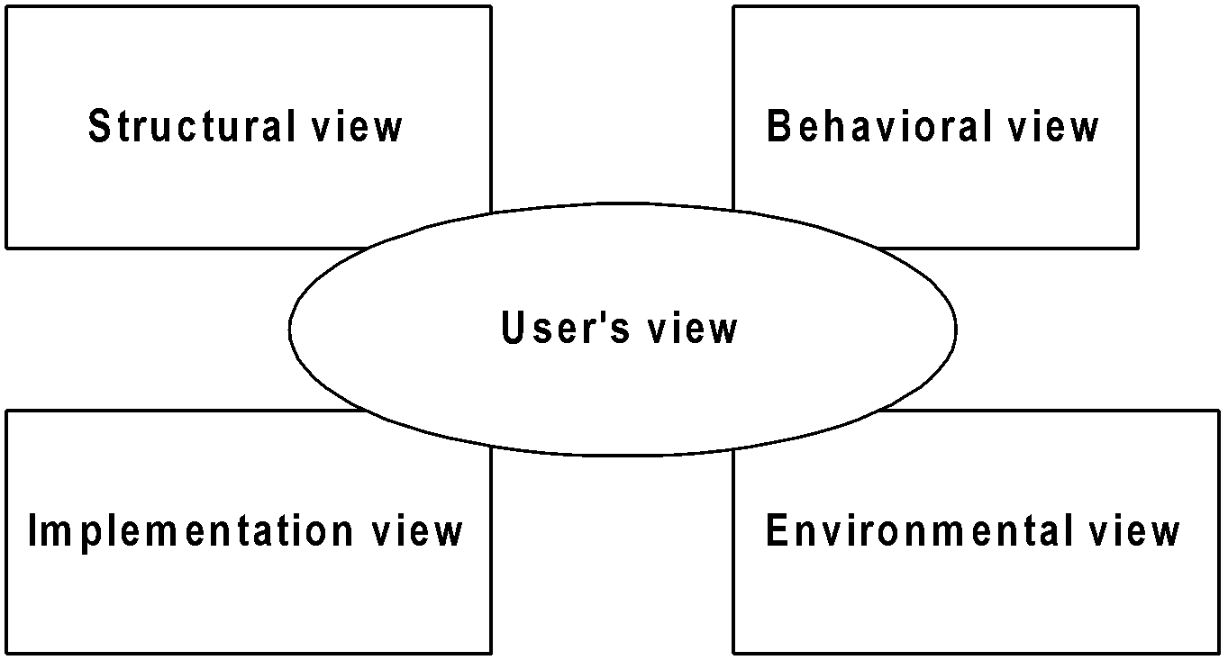
Diagrams in UML
Any system can be viewed with five interrelated views

Slide 50
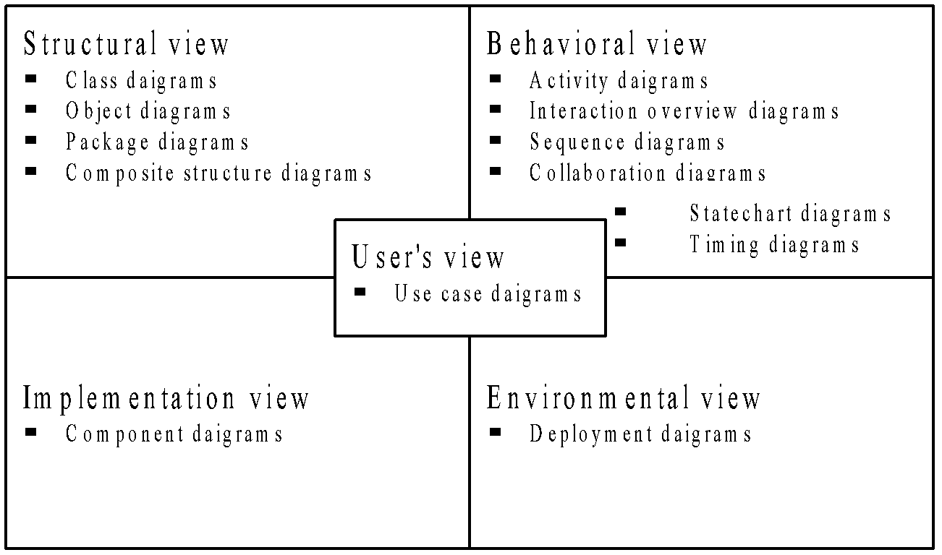
Diagrams in UML
To represent each view, UML provides nine diagrams, popularly termed as UML diagrams or UML artifacts

